Slide 1
Views

Slide 2
Introduction
MySQL Views are the database objects that can be created on a table to improve the performance of MySQL Server. A view has unique Constraints. look on data from one or more tables. It can organize data in unique order, focus or hide some data.

Slide 3
Introduction
MySQL Views comprises of a stored query accessible as a fundamental table composed of the outcome set. Beside standard tables a perspective does not shaped a part of the physical schema. It is a virtual table, dynamic in the database.
View is a stored query, and it can be attributed like a table.

Slide 4
Views
MySQL Views object is mainly classified into
Create view
Alter view
Drop view

Slide 5
Views
Once a view is created from base table, all DML operations can be performed on that view which effects its base table. This kind of view is called simple view.
Create any number of columns in a table. The system privileges are required to create own schema, and can execute any object privilege on object type.

Slide 6
Syntax
create view <table_name>as select <column_name> FROM <table_name> where <condition>;
table_name => Any accurate table.
column_name => The columns that inserted in the table.
Condition => The condition to get the specific result set .

Slide 7
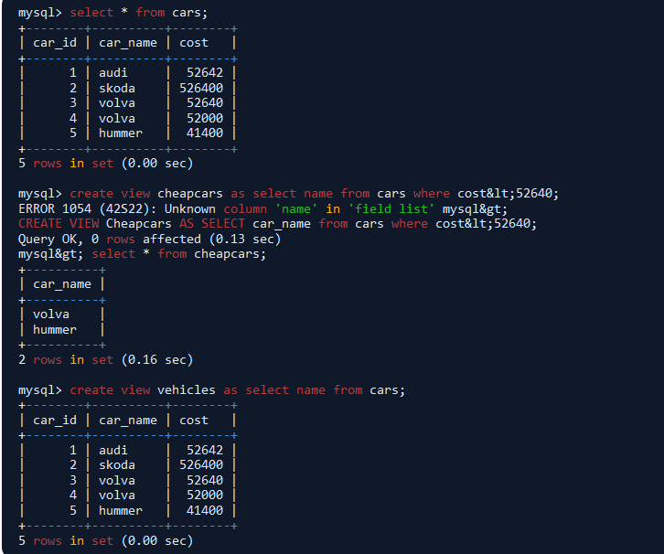

Slide 8
Example
In the above example, a simple table cars has been created and by applying view operation to that table, like inserting some condition on column name.(i.e.,cost of car<52640 is the condition, and it show the cost of cars less than that value).

Slide 9
About Views
Once a view is created from base table, all alter operations can be performed on that view which effects its base table.
The alter view proclamation is like the create view proclamation aside from create is replaced with alter keyword.

Slide 10
Indexes

Slide 11
Introduction
A database index is a data structure that improves the speed of operations in a table. Indexes can be created using one or more columns, providing the basis for both rapid random lookups and efficient ordering of access to records.
While creating index, it should be taken into consideration which all columns will be used to make SQL queries and create one or more indexes on those columns.

Slide 12
The users cannot see the indexes, they are just used to speed up queries and will be used by the Database Search Engine to locate records very fast.
The INSERT and UPDATE statements take more time on tables having indexes, whereas the SELECT statements become fast on those tables. The reason is that while doing insert or update, a database needs to insert or update the index values as well.

Slide 13
Simple and Unique Index
You can create a unique index on a table. A unique index means that two rows cannot have the same index value. Here is the syntax to create an Index on a table.
CREATE UNIQUE INDEX index_name ON table_name ( column1, column2,...);

Slide 14
Example
You can use one or more columns to create an index.
For example, we can create an index on tutorials_tbl using tutorial_author.
CREATE UNIQUE INDEX AUTHOR_INDEX ON tutorials_tbl (tutorial_author)

Slide 15
Modification of Indexes
ALTER command to add and drop INDEX
There are four types of statements for adding indexes to a table −
ALTER TABLE tbl_name ADD PRIMARY KEY (column_list) − This statement adds a PRIMARY KEY, which means that the indexed values must be unique and cannot be NULL.
ALTER TABLE tbl_name ADD UNIQUE index_name (column_list) − This statement creates an index for which the values must be unique (except for the NULL values, which may appear multiple times).
ALTER TABLE tbl_name ADD INDEX index_name (column_list) − This adds an ordinary index in which any value may appear more than once.
ALTER TABLE tbl_name ADD FULLTEXT index_name (column_list) − This creates a special FULLTEXT index that is used for text-searching purposes.

Slide 16
Displaying INDEX Information
We can use the SHOW INDEX command to list out all the indexes associated with a table. The vertical-format output (specified by \G) often is useful with this statement, to avoid a long line wraparound −
Try out the following example −
mysql> SHOW INDEX FROM table_name\G

Slide 17
Temporary Tables

Slide 18
What are temporary tables
Temporary tables were added in the MySQL Version 3.23. If you use an older version of MySQL than 3.23, you cannot use the temporary tables, but you can use Heap Tables.
As stated earlier, temporary tables will only last as long as the session is alive. If you run the code in a PHP script, the temporary table will be destroyed automatically when the script finishes executing. If you are connected to the MySQL database server through the MySQL client program, then the temporary table will exist until you close the client or manually destroy the table.

Slide 19
Example
The following program is an example showing you the usage of the temporary table. The same code can be used in PHP scripts using the mysql_query() function.
mysql> CREATE TEMPORARY TABLE SalesSummary ( -> product_name VARCHAR(50) NOT NULL -> , total_sales DECIMAL(12,2) NOT NULL DEFAULT 0.00 -> , avg_unit_price DECIMAL(7,2) NOT NULL DEFAULT 0.00 -> , total_units_sold INT UNSIGNED NOT NULL DEFAULT 0 ); Query OK, 0 rows affected (0.00 sec)

Slide 20
Example
mysql> INSERT INTO SalesSummary -> (product_name, total_sales, avg_unit_price, total_units_sold) -> VALUES -> ('cucumber', 100.25, 90, 2);
mysql> SELECT * FROM SalesSummary; +--------------+-------------+----------------+------------------+ | product_name | total_sales | avg_unit_price | total_units_sold | +--------------+-------------+----------------+------------------+ | cucumber | 100.25 | 90.00 | 2 | +--------------+-------------+----------------+------------------+ 1 row in set (0.00 sec)

Slide 21
When you issue a SHOW TABLES command, then your temporary table would not be listed out in the list.

Slide 22
Dropping Temporary Tables
By default, all the temporary tables are deleted by MySQL when your database connection gets terminated. Still if you want to delete them in between, then you do so by issuing the DROP TABLE command.
The following program is an example on dropping a temporary table −
mysql> CREATE TEMPORARY TABLE SalesSummary ( -> product_name VARCHAR(50) NOT NULL -> , total_sales DECIMAL(12,2) NOT NULL DEFAULT 0.00 -> , avg_unit_price DECIMAL(7,2) NOT NULL DEFAULT 0.00 -> , total_units_sold INT UNSIGNED NOT NULL DEFAULT 0 ); Query OK, 0 rows affected (0.00 sec)

Slide 23
Thank You

